Slide 1

A[53.7] FO4_{(1V)},[183.02] E_{u(1V)} 4-bit Absolute Value Detector
G7 Team member: Chengming Li, Haowei Ge, Rui Yang and Zhuohao Chang

Slide 2
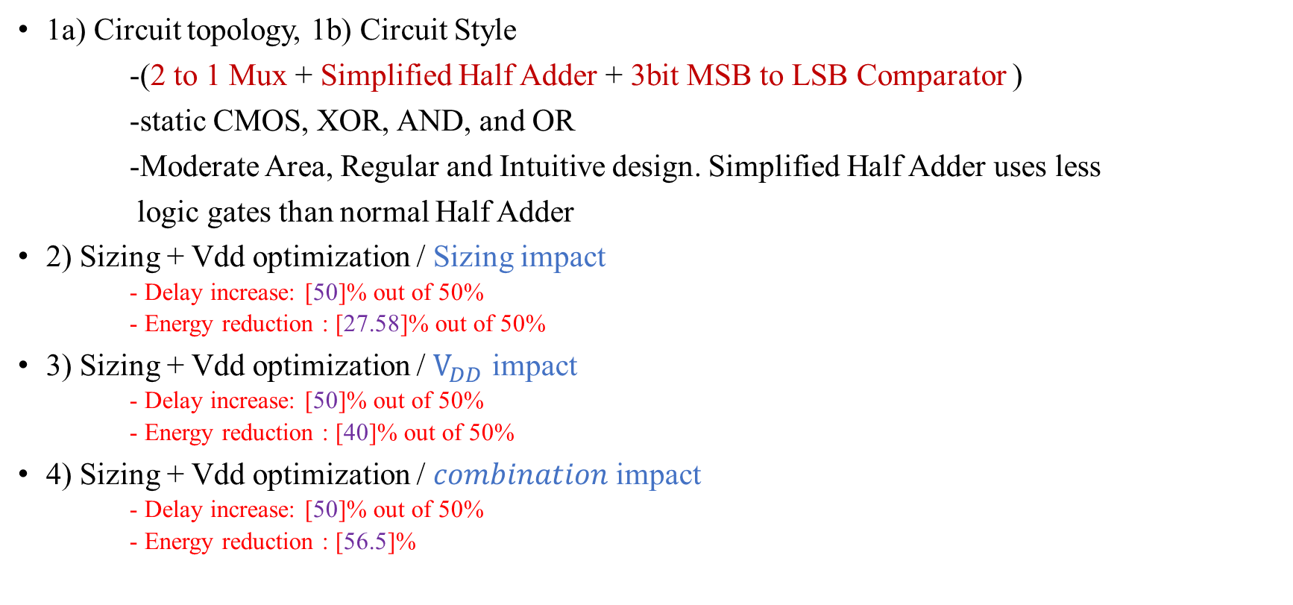
Design Summary
1a) Circuit topology, 1b) Circuit Style
-(2 to 1 Mux + Simplified Half Adder + 3bit MSB to LSB Comparator )
-static CMOS, XOR, AND, and OR
-Moderate Area, Regular and Intuitive design. Simplified Half Adder uses less
logic gates than normal Half Adder
2) Sizing + Vdd optimization / Sizing impact
- Delay increase: [50]% out of 50%
- Energy reduction : [27.58]% out of 50%
3) Sizing + Vdd optimization / $V_{DD}$ impact
- Delay increase: [50]% out of 50%
- Energy reduction : [40]% out of 50%
4) Sizing + Vdd optimization / $combination$impact
- Delay increase: [50]% out of 50%
- Energy reduction : [56.5]%

Slide 3
Design Preview
1. Decide the sign of given input , i.e., compared input bit 3(A₃) with logic 0.
One input with A₃ and another input connects to ground.
2. Building a 3 bit 2’s complement circuit, decision done by the step 1.
Output 3-bit magnitude
3. Output from step 2 and compared it with given threshold value(3-bit comparator).

Slide 4
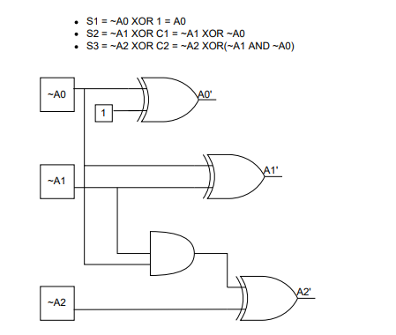
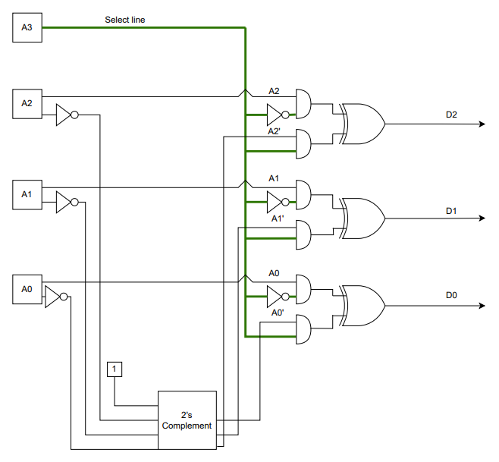
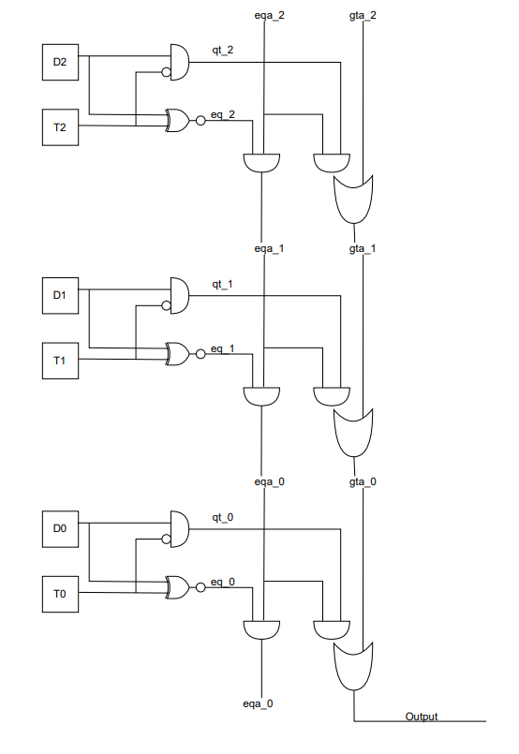
Design Topology & Reasoning
Schematic
Simplified Half Adder 2-1 Mux(2’s Complement refers figure 1) 3-bit Comparator

Slide 5
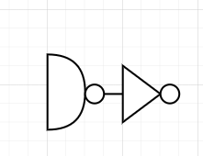
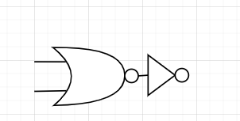
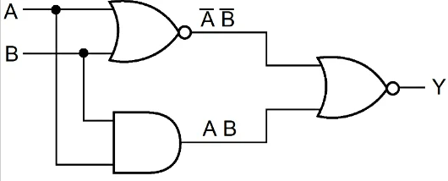
Design Topology (Continuing)
AND gate can be implemented as below
OR gate can be implemented as below
XOR gate can be implemented as below

Slide 6
Design Topology & Reasoning
Reasoning
-This is an intuitive design, and we got ideas from combinational logic.
-Beyond that, we made a little improvement on the Half-Adder design, which uses less
logic gates and so transistors. Thus, it saves energy from the design perspective.
Other options
- We have considered the full adder, ripple adder, etc. But we thought it was not necessary to put a full adder into the design, since we were not designing an ALU to do a very complex calculation. And main goal of this design is saving energy and with less transitors

Slide 7
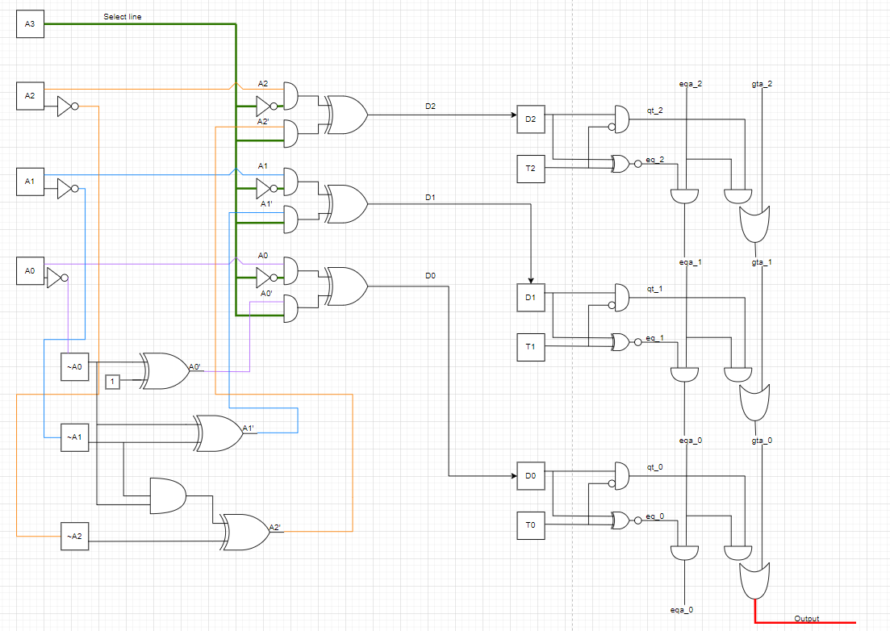


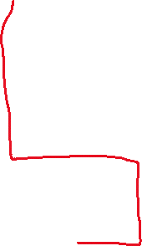
Critical Path Analysis
Highlight Critical Path

Slide 8
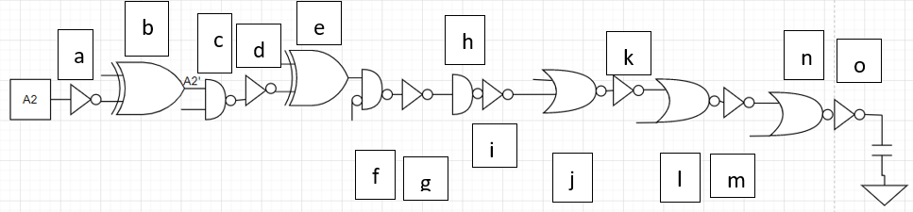
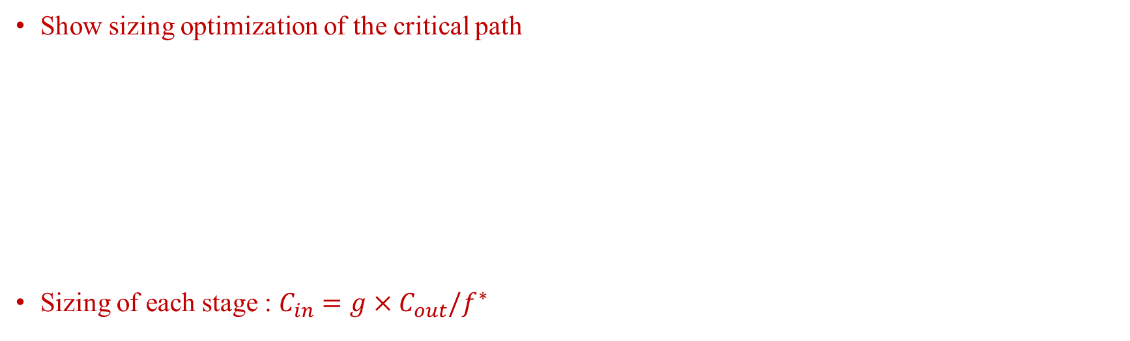
Critical Path Gate Sizing Approach
Show sizing optimization of the critical path
Sizing of each stage : $C_{in}=g×C_{out}/f^{∗}$
a = 1 | b = 1.78 | c = 0.79 | d = 1.05 | e = 1.88 | f = 0.83 | g = 1.11 | h = 1.98
i = 2.64 | j = 4.69 | k = 5 | l = 8.9 | m = 9.49 | n = 16.9 | o = 18 | Cout = 32

Slide 9
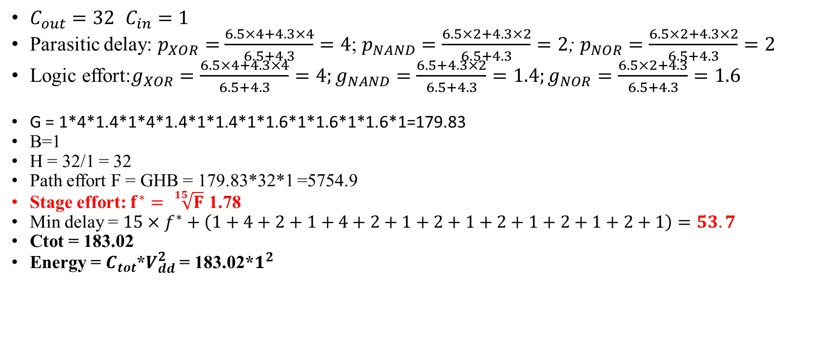
Critical Path Gate Sizing Approach（Continuing）
$C_{out}=32$ $C_{in}=1$
Parasitic delay: $p_{XOR}=$ $\frac{6.5×4+4.3×4}{6.5+4.3}=4$; $p_{NAND}=\frac{6.5×2+4.3×2}{6.5+4.3}=2$; $p_{NOR}=\frac{6.5×2+4.3×2}{6.5+4.3}=2$
Logic effort:$g_{XOR}=\frac{6.5×4+4.3×4}{6.5+4.3}=4;g_{NAND}=\frac{6.5+4.3×2}{6.5+4.3}=1.4;g_{NOR}=\frac{6.5×2+4.3}{6.5+4.3}=1.6$
G = 1*4*1.4*1*4*1.4*1*1.4*1*1.6*1*1.6*1*1.6*1=179.83
B=1
H = 32/1 = 32
Path effort F = GHB = 179.83*32*1 =5754.9
Stage effort: $f^{∗}= \sqrt[15]{F}$ 1.78
Min delay = $15×f^{∗}+\left(1+4+2+1+4+2+1+2+1+2+1+2+1+2+1\right)=53.7$
Ctot = 183.02
Energy = $C_{tot}$*$V_{dd}^{2}$ = 183.02*$1^{2}$

Slide 10


Sizing & $V_{DD}$ Energy Minimization
Sizing impact
By using excel model provided in the lecture, $E_{tot}$drops down to 132.54, as 1.5* ${Delay}_{min}$
Vdd impact
$Dmin=\frac{K∗Vdd}{{(Vdd−0.2)}^{2}}=53.64=\frac{K∗Vdd}{{(Vdd−0.2)}^{2}}$
K = 34.33
$1.5∗Dmin=\frac{53.64∗Vdd′}{{(Vdd−0.2)}^{2}}$
Vdd’ = 0.775
$\text{Energy}\text{ = }C_{tot}\text{∗}V_{dd}^{2}\text{ = }183.02×{0.775}^{2}=109.93$
Combination impact
$\text{Energy}\text{ = }C_{tot}\text{∗}V_{dd}^{2}\text{ = }132.54×{0.775}^{2}=79.61$

Slide 11

Sizing vs. $V_{DD}$ Optimization ?
How did you decide about relative contribution of sizing and VDD in your overall delay increase?
Calculated energy consumption using either sizing optimization or Vdd optimization.
Estimated the energy reduction in these two methods.
Greater energy reduction is the better way to reduce energy in the design
Vdd optimization is the better way for this design, since it reduces 40% energy when delay is 1.5 times minimum delay
We end up 56.5% energy reduction when both optimization are applied

Slide 12
Discussion & Summary
Three most important features of our design
1. Simplified Half-Adder Circuit
2. Intuitive Design
3. 3bit Comparator, from MSB to LSB, using gt and eq signal.
Given another chance, 3 things you would do different
1. Trying using PTL
2. Calculate other paths’ delay
3. We have little problem in our excel solver, as one of the stage effort is 0. But we can’t figure out the cause of this problem. I think we could do it better if there is more time provided

Slide 13
Q&A

